Slide 1



BIDANG DATA MINING
Tren dan Ide Riset
Dr. Achmad Solichin, M.T.I | Universitas Budi Luhur

Slide 2
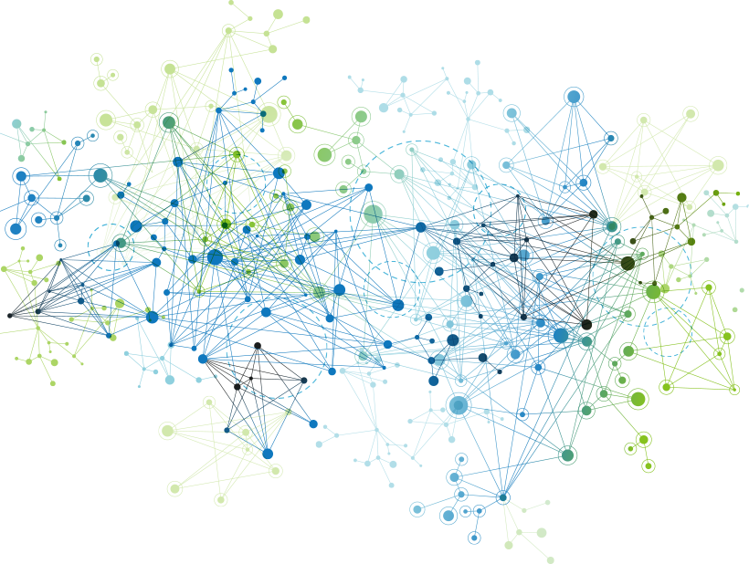
Apa itu Data Mining?
Disiplin ilmu yang mempelajari metode untuk mengekstrak pengetahuan atau menemukan pola dari suatu data yang besar.

Slide 3

Proses Data Mining: CRISP-DM

Slide 4
Proses Data Mining
1. Himpunan Data
(Pahami dan Persiapkan Data)
2. Metode Data Mining (Pilih Metode Sesuai Karakter Data)
3. Pengetahuan
(Pahami Model dan Pengetahuan yg Sesuai )
4. Evaluation
(Analisis Model dan Kinerja Metode)
DATA PREPROCESSING
Data Cleaning
Data Integration
Data Reduction
Data Transformation
MODELING
Estimation
Prediction
Classification
Clustering
Association
MODEL
Formula
Tree
Cluster
Rule
Correlation
KINERJA
Akurasi
Tingkat Error
Jumlah Cluster
MODEL
Atribute/Faktor
Korelasi
Bobot

Slide 5






TOP FREE DATA MINING TOOLS

Slide 6
DATA PREPROCESSING
1
2
3
4
Data cleaning
Fill in missing values
Smooth noisy data
Identify or remove outliers
Resolve inconsistencies
Data reduction
Dimensionality reduction
Numerosity reduction
Data compression
Data transformation and discretization
Normalization
Concept hierarchy generation
Data integration
Integration of multiple databases or files

Slide 7
Metode Data mining
Klasifikasi (Classification)
Decision Tree / C4.5
Naïve Bayes
K-NN
Klasterisasi (Clustering)
K-Means
Asosiasi (Association)
Apriori / Association Rule
Estimasi dan Peramalan
Linear Regression
Neural Network
Support Vector Machine
FP-Growth
K-Medoids
DBSCAN
dll
dll
ID3
dll
dll
Fuzzy C-Means

Slide 8
EVALUASI MODEL Data mining
Klasifikasi (Classification)
Confusion Matrix: Accuracy
Klasterisasi (Clustering)
Davies–Bouldin index
Asosiasi (Association)
Lift Ratio
Estimasi dan Peramalan
RMSE
dll
dll
dll
dll
ROC Curve: Area Under Curve (AUC)
Dunn index
F-measure
MSE
MAPE

Slide 9

DATA
ADALAH FOKUS UTAMA DARI RISET BIDANG DATA MINING

Slide 10
TREN DAN IDE RISET DATA MINING
Educational Data Mining
Social Media Data Mining
Healthcare Data Mining
Multimedia Data Mining
Geographic Data Mining

Slide 11

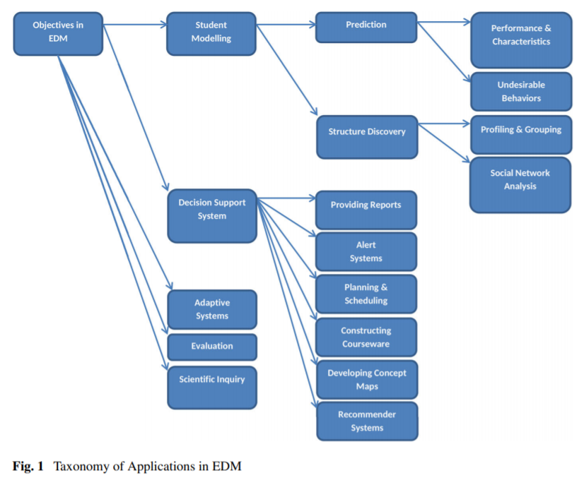
#1. EDUCATIONAL DATA MINING
Predicting performance and characteristics
Detecting undesirable student behaviour
Profiling and Grouping students
Social Network Analysis
Providing reports
Creating alerts for stakeholders
Planning and scheduling
Constructing courseware
Developing Concept Maps
Generating recommendation
Evaluation
Adaptive systems
Scientific inquiry
Notes:
Sumber: Bakhshinategh, B., Zaiane, O.R., ElAtia, S. et al. Educational data mining applications and tasks: A survey of the last 10 years. Educ Inf Technol 23, 537–553 (2018) doi: https://doi.org/10.1007/s10639-017-9616-z

Slide 12
#1. EDUCATIONAL DATA MINING
TOPIK | CONTOH PENELITIAN
Prediksi performa dan karakteristik siswa/mahasiswa | Prediksi Tingkat Kelulusan Mahasiswa Tepat Waktu Menggunakan Naive Bayes: Studi Kasus UIN Syarif Hidayatullah Jakarta (Salmu & Solichin, 2017) - http://achmatim.net/download/70 Prediksi Mahasiswa Drop Out Menggunakan Metode Support Vector Machine (Nurhayati, Kusrini & Luthfi, 2015) - http://dx.doi.org/10.30700/jst.v5i1.25
Prediksi gaya belajar siswa/mahasiswa | Detecting Learning Styles in Learning Management Systems Using Data Mining (Liyanage, Gunawardena & Hirakawa, 2016) - https://doi.org/10.2197/ipsjjip.24.740 VARK Learning Style Classification Using Decision Tree with Physiological Signals (Dutsinma & Temdee, 2020) - https://doi.org/10.1007/s11277-020-07196-3
Penjurusan siswa/mahasiswa | Penerapan Metode Naïve Bayes Classifier Untuk Penjurusan Siswa Pada Madrasah Aliyah Al-Falah Jakarta (Mafakhir & Solichin, 2020) - http://dx.doi.org/10.21111/fij.v5i1.4007 Integrasi Metode Naive Bayes dengan K-Means dan K-Means-Smote untuk Klasifikasi Jurusan SMAN 3 Mataram (Hairani, Hansyah & Mardedi, 2020) - https://doi.org/10.30864/jsi.v15i1.317

Slide 13
#1. EDUCATIONAL DATA MINING
TOPIK | CONTOH PENELITIAN
Rekomendasi pengambilan matakuliah | Rekomendasi Pengambilan Mata Kuliah Pilihan Untuk Mahasiswa Sistem Informasi Menggunakan Algoritme Decision Tree (Iswara dkk, 2019) - http://dx.doi.org/10.25126/jtiik.201963892 Penerapan Naïve Bayes Classifier Untuk Pemilihan Konsentrasi Mata Kuliah (Fadillah & Hardiyana, 2018) - https://doi.org/10.34010/jati.v8i2.1039
Adaptive systems | Case Based Reasoning Adaptive E-Learning System Based On Visual-Auditory-Kinesthetic Learning Styles (Rahman & Budiyanto, 2019) - https://ieeexplore.ieee.org/document/8976921 An Adaptive Educational Data Mining Technique for Mining Educational Data Models in Elearning Systems (Murugananthan & ShivaKumar, 2016) – http://10.17485/ijst/2016/v9i3/86392
Gamification | The use of gamification in education: a bibliometric and text mining analysis (Martí‐Parreño, Méndez‐Ibáñez & Alonso‐Arroyo, 2016)- https://doi.org/10.1111/jcal.12161

Slide 14

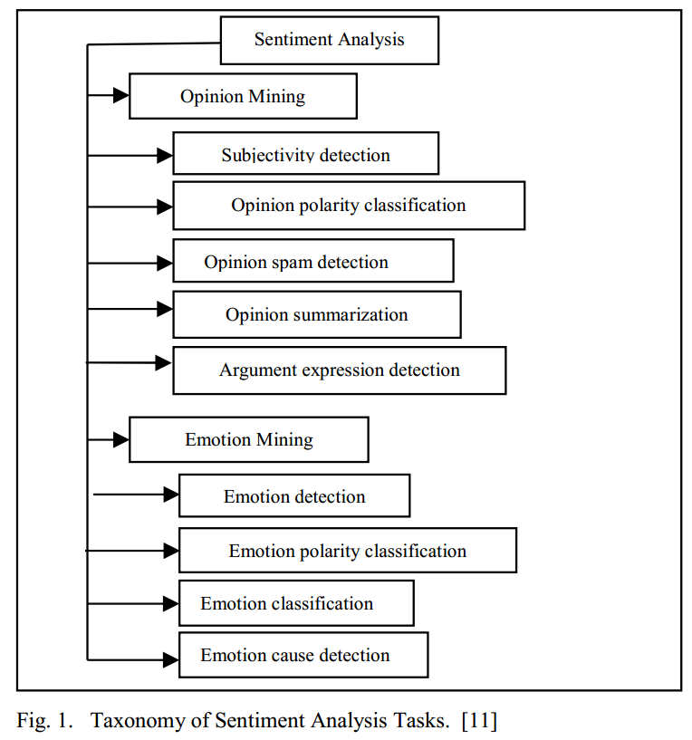
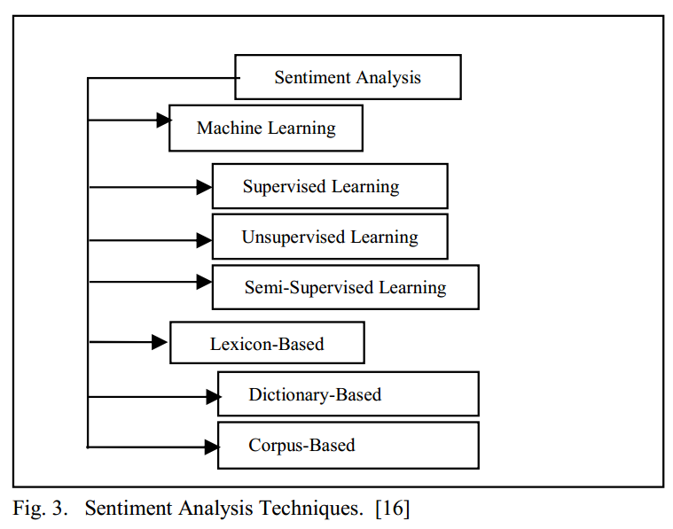
#2. SOCIAL MEDIA DATA MINING
Notes:
Sumber: The Essential of Sentiment Analysis and Opinion Mining in Social Media : Introduction and Survey of the Recent Approaches and Techniques - https://ieeexplore.ieee.org/document/8743799

Slide 15
#2. SOCIAL MEDIA DATA MINING
TOPIK | CONTOH PENELITIAN
Analisis Sentimen | Rofiqoh, U., Perdana, R.S. and Fauzi, M.A., 2017. Analisis sentimen tingkat kepuasan pengguna penyedia layanan telekomunikasi seluler indonesia pada twitter dengan metode Support Vector Machine dan Lexicon Based Features. Jurnal Pengembangan Teknologi Informasi dan Ilmu Komputer e-ISSN, 2548, p.964X. Giovani, A.P., Ardiansyah, A., Haryanti, T., Kurniawati, L. and Gata, W., 2020. Analisis Sentimen Aplikasi Ruang Guru Di Twitter Menggunakan Algoritma Klasifikasi. Jurnal Teknoinfo, 14(2), pp.115-123.
Analisis Emosi | Ranganathana & Tzacheva, 2019. Emotion Mining in Social Media Data. Procedia Computer Science Volume 159, 2019, Pages 58-66 Krebs dkk, 2017. Social Emotion Mining Techniques for Facebook Posts Reaction Prediction. Code: https://github.com/jerryspan/FacebookR
Fake news / hoax detection | Hoax News Detection on Social Media: A Survey (Assiroj dkk, 2018) - https://doi.org/10.1109/INAPR.2018.8627053 Bharadwaj, Pranav and Shao, Zongru, Fake News Detection with Semantic Features and Text Mining. International Journal on Natural Language Computing (IJNLC) Vol.8, No.3, June 2019, Available at SSRN: https://ssrn.com/abstract=3425828

Slide 16

#3. HEALTHCARE DATA MINING
TOPIK / DATA | CONTOH PENELITIAN
Deteksi / diagnosis penyakit | Penerapan Algoritma J48 Untuk Deteksi Penyakit Tiroid (Agustiani dkk, 2020) - https://doi.org/10.31294/p.v22i2.8174 Preliminary Diagnosis of Pulmonary Tuberculosis Using Ensemble Method (Winarko, Rusdah & Wardoyo, 2015) - https://doi.org/10.1109/ICODSE.2015.7436993
Pemberian Obat | Hypertension Drug Suitability Evaluation Based On Patient Condition with Improved Profile Matching (Soetanto, dkk, 2018) - http://doi.org/10.11591/ijeecs.v11.i2.pp453-461 Mining Adverse Drug Side-Effects from Online Medical Forums (Sampathkumar, Luo & Chen, 2012) -https://doi.org/10.1109/HISB.2012.75
Hospital Management | E-Referral System Modeling Using Fuzzy Multiple-Criteria Decision Making (Triyono dkk, 2018) - http://doi.org/10.11591/ijeecs.v11.i2.pp475-486 Mining medical data to identify frequent diseases using Apriori algorithm (Ilayaraja & Meyyappan, 2013) - https://doi.org/10.1109/ICPRIME.2013.6496471
Notes:
Sumber: Patel, S. and Patel, H., 2016. Survey of data mining techniques used in healthcare domain. International Journal of Information, 6(1/2), pp.53-60.

Slide 17
#3. HEALTHCARE DATA MINING
Klasterisasi Persebaran Virus Corona (Covid-19) Di DKI Jakarta Menggunakan Metode K-Means (Solichin & Khairunnisa, 2020) - http://dx.doi.org/10.21111/fij.v5i2.4905
Application of Needleman-Wunch Algorithm to identify mutation in DNA sequences of Corona virus - https://iopscience.iop.org/article/10.1088/1742-6596/1218/1/012031
Analisis Sentimen Pandemi Covid-19 pada Streaming Twitter dengan Text Mining Python - https://p3m.sinus.ac.id/jurnal/index.php/e-jurnal_SINUS/article/view/491/pdf
Study on COVID-19 in the World and Indonesia Using Regression Model of SVM, Bayesian Ridge and Gaussian - https://ejournal.unsrat.ac.id/index.php/JIS/article/view/28256
COVID-19 Spread Pattern Using Support Vector Regression - https://doi.org/10.33558/piksel.v8i1.2024

Slide 18

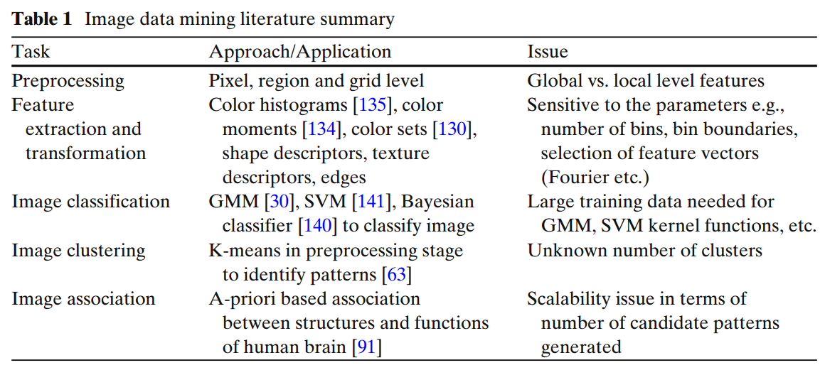
#4. MULTIMEDIA DATA MINING
Notes:
Sumber: Bhatt, C.A., Kankanhalli, M.S. Multimedia data mining: state of the art and challenges. Multimed Tools Appl 51, 35–76 (2011). https://doi.org/10.1007/s11042-010-0645-5

Slide 19
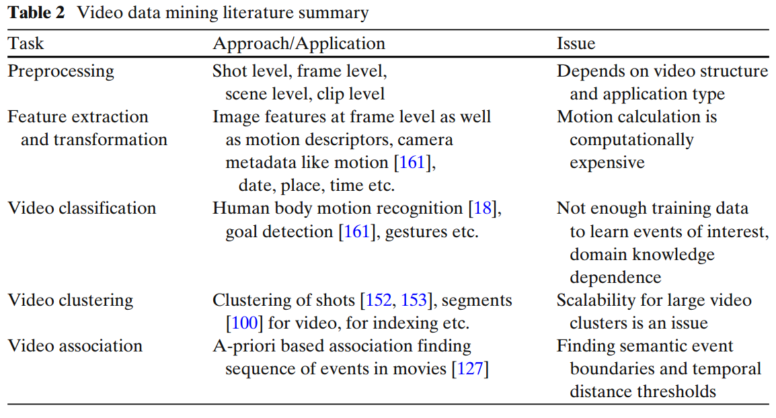
#4. MULTIMEDIA DATA MINING
Notes:
Sumber: Bhatt, C.A., Kankanhalli, M.S. Multimedia data mining: state of the art and challenges. Multimed Tools Appl 51, 35–76 (2011). https://doi.org/10.1007/s11042-010-0645-5

Slide 20
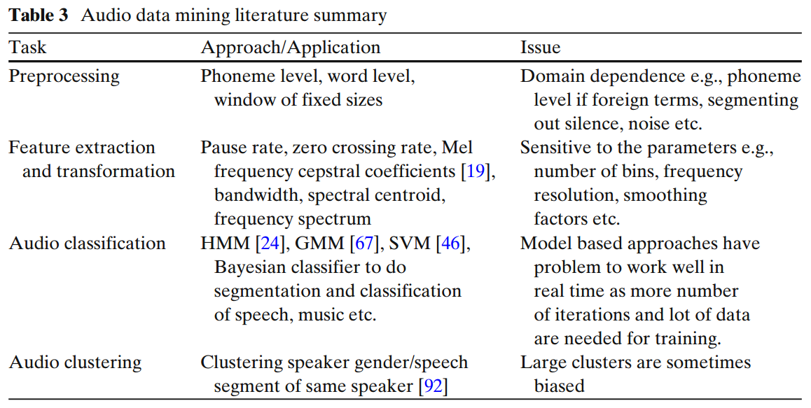
#4. MULTIMEDIA DATA MINING
Notes:
Sumber: Bhatt, C.A., Kankanhalli, M.S. Multimedia data mining: state of the art and challenges. Multimed Tools Appl 51, 35–76 (2011). https://doi.org/10.1007/s11042-010-0645-5

Slide 21

#5. GEOGRAPHIC/SPATIAL DATA MINING
Bruce K. Wylie, Neal J. Pastick, Joshua J. Picotte & Carol A. Deering (2019) Geospatial data mining for digital raster mapping, GIScience & Remote Sensing, 56:3, 406-429, DOI: http://10.1080/15481603.2018.1517445
Choi, H. Geospatial Data Approach for Demand-Oriented Policies of Land Administration. Land 2020, 9, 31. DOI: https://doi.org/10.3390/land9010031
M. S. Suchithra and M. L. Pai, "Data Mining based Geospatial Clustering for Suitable Recommendation system," 2020 International Conference on Inventive Computation Technologies (ICICT), Coimbatore, India, 2020, pp. 132-139, doi: https://10.1109/ICICT48043.2020.9112562.
Analysis of land cover changes after the eruption of mount Sinabung using satellite imagery - https://doi.org/10.1088/1742-6596/1402/2/022108

Slide 22
REFERENSI
Bakhshinategh, B., Zaiane, O.R., ElAtia, S. et al. Educational data mining applications and tasks: A survey of the last 10 years. Educ Inf Technol 23, 537–553 (2018) doi: https://doi.org/10.1007/s10639-017-9616-z
H. Soong, N. B. A. Jalil, R. Kumar Ayyasamy and R. Akbar, "The Essential of Sentiment Analysis and Opinion Mining in Social Media : Introduction and Survey of the Recent Approaches and Techniques," 2019 IEEE 9th Symposium on Computer Applications & Industrial Electronics (ISCAIE), Malaysia, 2019, pp. 272-277, doi: https://10.1109/ISCAIE.2019.8743799.
Bhatt, C.A., Kankanhalli, M.S. Multimedia data mining: state of the art and challenges. Multimed Tools Appl 51, 35–76 (2011). https://doi.org/10.1007/s11042-010-0645-5

Slide 23

TERIMA KASIH | SEMOGA BERMANFAAT

